Slide 1
Preventing Suicide

Slide 2
How Can You Prevent Suicidal thoughts ?
First of all You should find a professional to talk to such as a therapist.
If You can’t get a therapist try to talk your parent if not find a close relative or friend to talk to .
Think positive in life
Think about what makes you happy ,think about what kind of life you can have
Think about how valuable your life it , treasure it
Think about your future
Life Is a gift don’t waste it because you have a crisis In life or people put you down

Slide 3
Resources & Information
Web Site/Printed Material Name:
http://www.emedicinehealth.com/
This website provides you helpful ways on how to prevent suicide
Symptoms
Medical Treatment
Causes of suicidal thoughts
Web Site/Printed Material Name:
http://www.who.int
Provides you with data & statistics
World wide comments & help
Programs for suicidal thoughts

Slide 4
Tips For Teens
Teens you are going threw bad things in life that give you suicidal thoughts , than this is for you .
If You are having suicidal thoughts think of what you have ahead of you , don’t let anyone bring you down . Your life is a gift & you should cherish it & not do reckless things. You Only live once don’t mess up your life by making harmful decisions.
When in doubt talk to a parent or a close friend
Don’t give up on life so easily ,no matter what the case

Slide 5
Tips For Parents
Always be there for your child
Try to help solve your kids problems
Be there when your kid needs someone to talk to
Motivate your kids
Talk to your kids more
Pay more attention to your kids
Put your kids before anyone

Slide 6
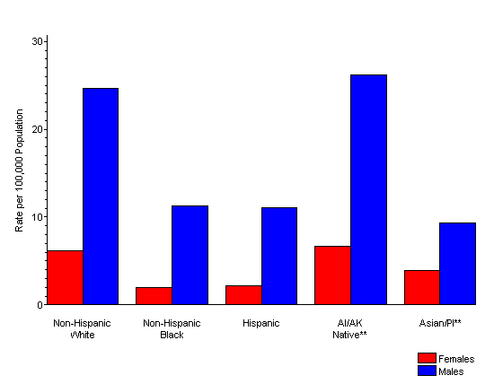
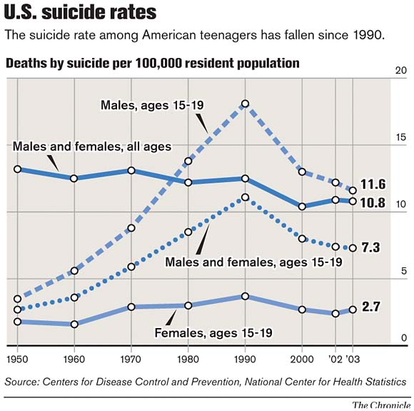
Rates

Slide 7
Understanding Suicidal thoughts
Feeling down from time to time is a normal part of life. But when emptiness and despair take hold and won't go away, I tmay be depression. More than just the temporary "blues," the lows of depression make it tough to function and enjoy life like you once did. Hobbies and friends don’t interest you like they used to; you’re exhausted all the time; and just getting through the day can be overwhelming. When you’re depressed, things may feel hopeless, but with help and support you can get better. But first, you need to understand depression. learning about depressionin cluding its signs, symptoms, causes, and treatment is the first step to overcoming the problem.

Slide 8
Dealing with Suicidal thoughts
Suicide is not chosen; it happens when pain exceeds resources for coping with pain.
If you are thinking about suicide, you are not alone. Many people have thoughts of suicide, for a number
of reasons. Thoughts of suicide can be very scary. You probably feel hurt, confused, overwhelmed and
hopeless about your future. You may feel sadness, grief, anger, guilt, shame, or emptiness. You may think
that nothing can be done to change your situation. Your feelings may seem like they are just too much to
handle right now. It is important to know that thinking about suicide does not mean that you will lose
control or act on these thoughts. Having thoughts of suicide does not mean you are weak, or ‘crazy’.
Many people think about suicide because they are looking for a way to escape the pain they are feeling

Slide 9
Stay Positive
Negative thoughts drain you of energy and keep you from being in the present moment. The more you give in to your negative thoughts, the stronger they become. I like the imagery of a small ball rolling along the ground, and as it rolls, it becomes bigger and faster.
That’s what one small negative thought can turn into: a huge, speeding ball of ugliness. On the contrary, a small positive thought can have the same effect blossoming into a beautiful outcome.

Slide 10
Created By Alaysha Bodden
Reminders
Never let people pressure you
Follow a good path
Think positive
Focus on the good things in life

